Slide 1


Slide 2

Introduction
Mahfuz Ara Sultana
Assistant Teacher,
Carmichael College Government Primary School,
Sadar, Rangpur

Slide 3


Today’s Lesson
Class-Three
Subject-English
Unit-1- , Lesson-5
A rhyme- Teapot
(First four lines)

Slide 4
Learning outcome
based on competencies
Student will be able to-
1.repeat rhyme after the teacher and recite.
2.read aloud the rhyme with proper pronunciation and stress.
3.recognize punctuation marks and read accordingly.
4.write the rhyme by using punctuation marks.

Slide 5

Let’s see a video

Slide 6
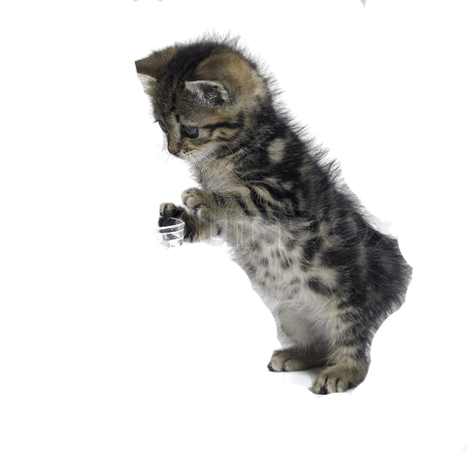
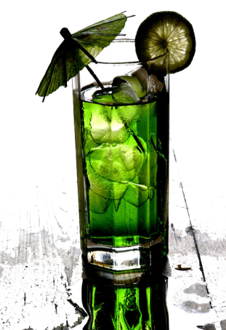
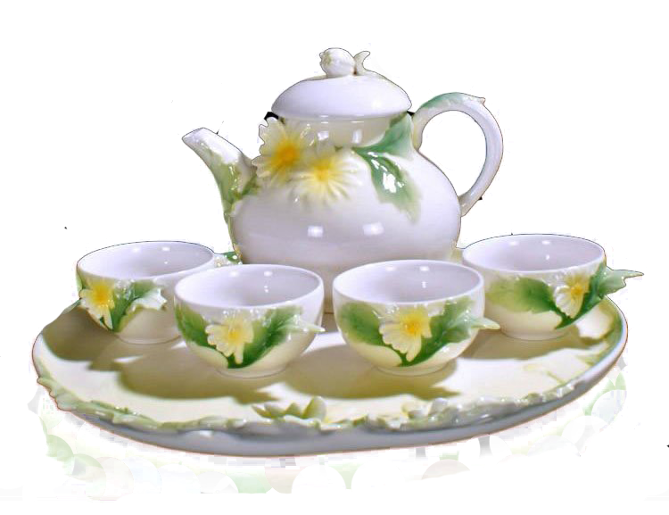
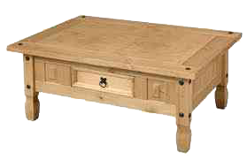
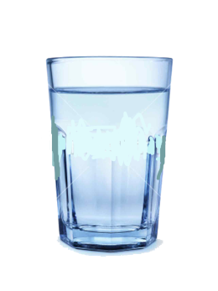
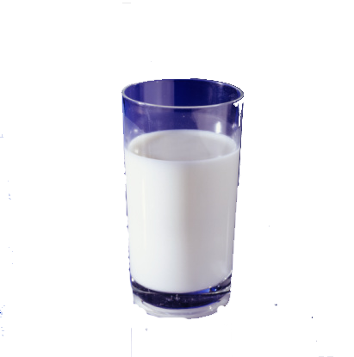
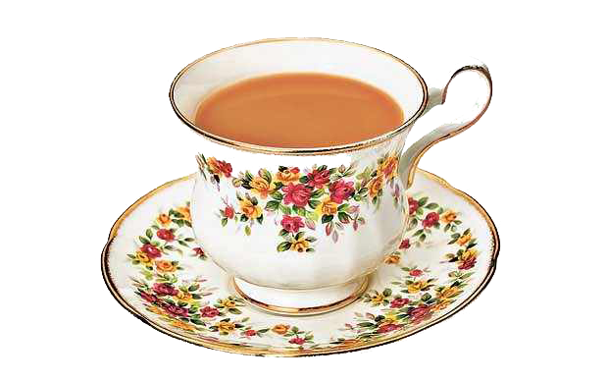
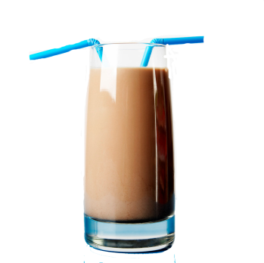
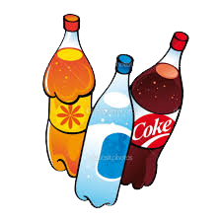
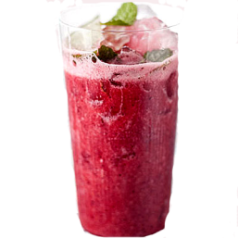
Tea is served by tea-pot and cup.
What type of drink do you like?
The cat wants to drink milk.
What the cat is doing?
Do you take tea?
How the tea is served?

Slide 7
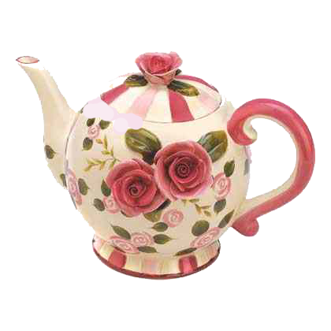
Now we read the rhyme.
Tea-pot

Slide 8
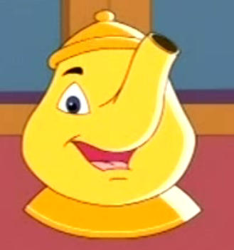
Let’s read the rhyme with the help of picture.
I am little tea-pot,
Short and stout.

Slide 9
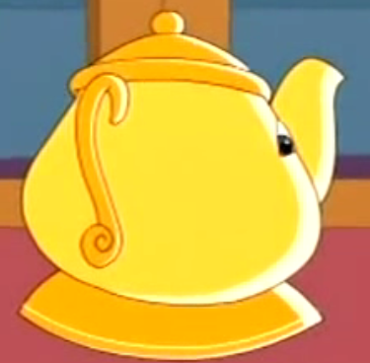
This is my handle,
And this is my spout.

Slide 10
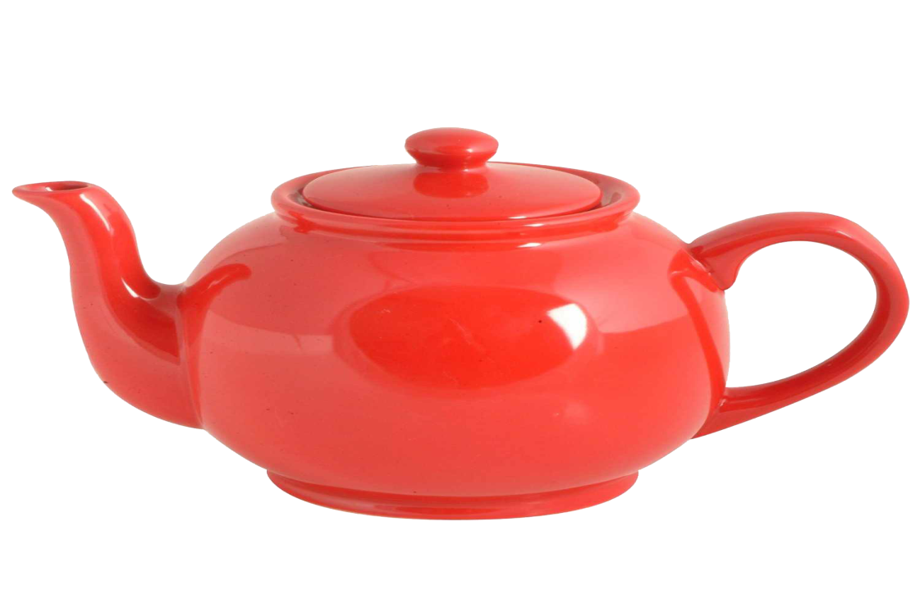
Word meaning, make sentence and pronunciation with appropriate stress and intonation.
Handle
Holding object
This is a handle

Slide 11
Word meaning, make sentence and pronunciation with appropriate stress and intonation.
Spout
Pipe or tube on a container
It is spout

Slide 12
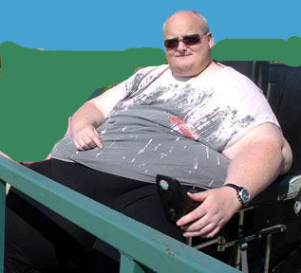
Word meaning, make sentence and pronunciation with appropriate stress and intonation.
Stout
Fat
He is a stout man.

Slide 13
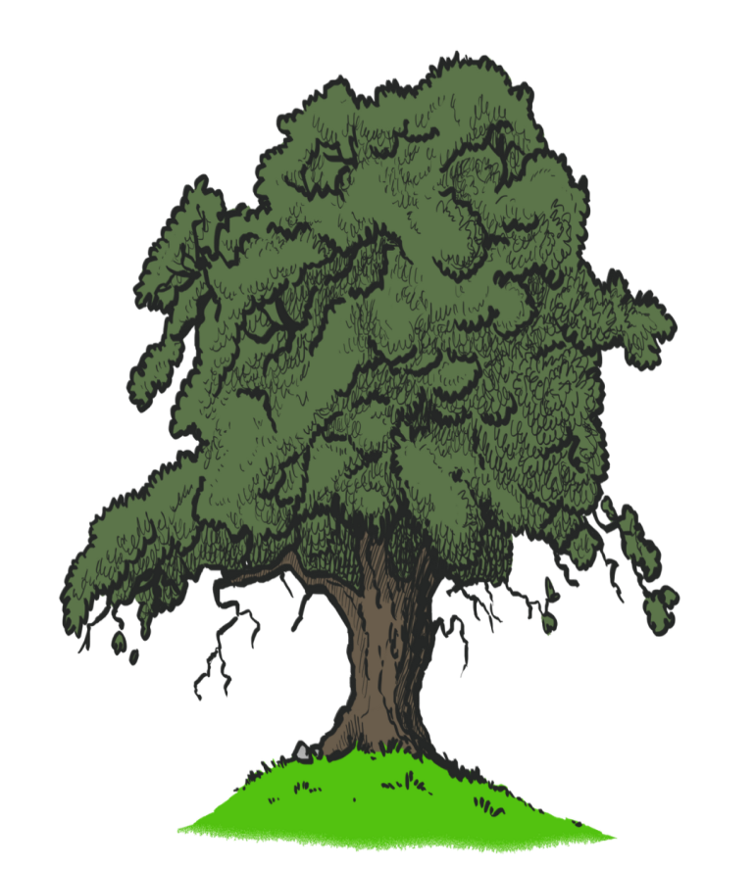
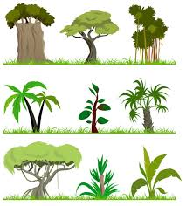
Word meaning, make sentence and pronunciation with appropriate stress and intonation.
Short
Small in size
This tree is short

Slide 14
Look at the punctuation mark.
Let’s read the frist 4 lines of the rhyme
Look at the capital letter.
I am a little tea-pot,
Short and stout.
This is my handle,
And this is my spout.
I
,
S
.
T
,
A
.

Slide 15
Let’s play kim’s game
Short
Spout
Stout
Handle

Slide 16
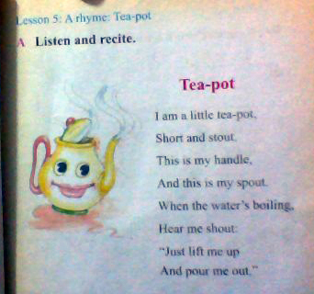
Open your book (page no :7 and silently read the first four lines.

Slide 17
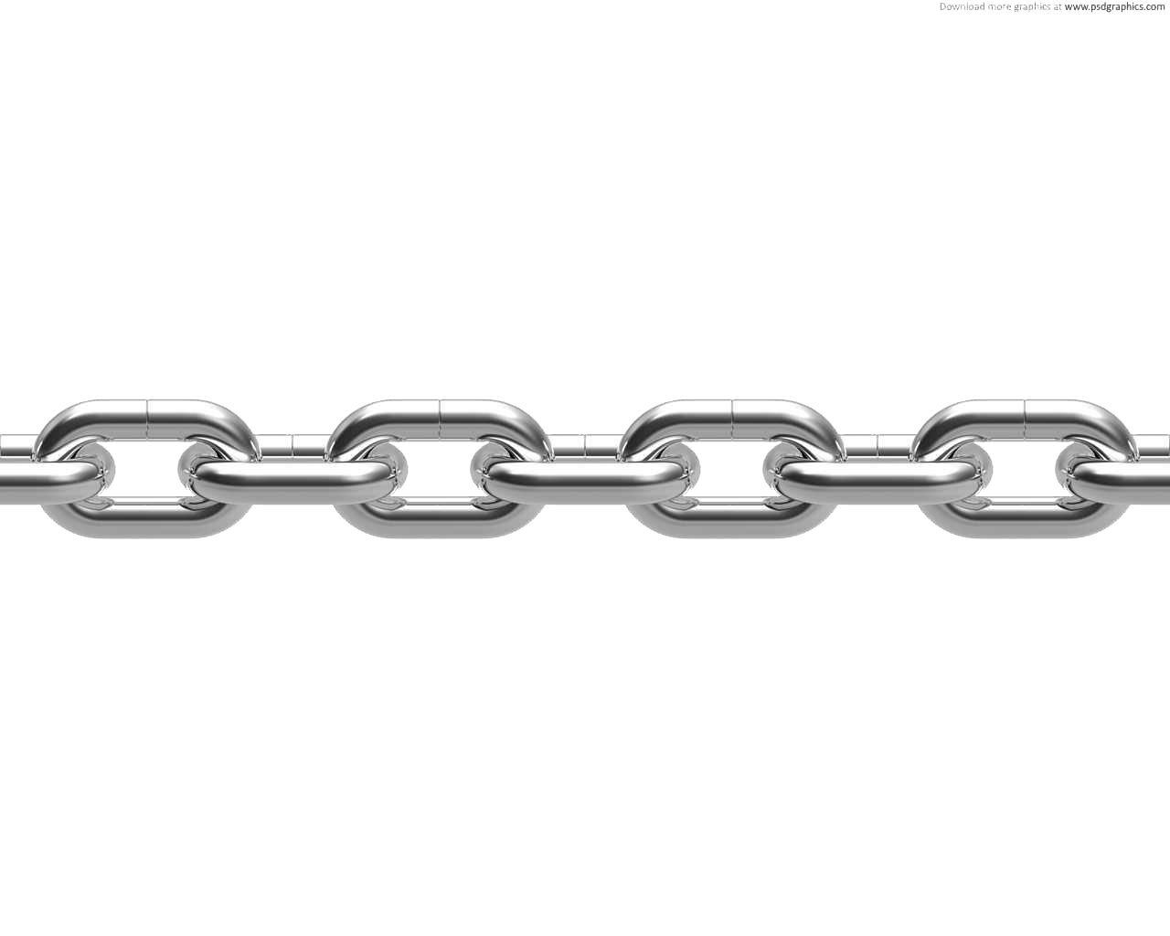
Group Work
  Recite the rhyme in chain drill
Group
I’m little tea-pot
Group
Short and stout.
Group
This is my handle
Group
And this is my spout.

Slide 18
Say the next line
I’m little tea-pot,
.............................................।
This is my handle,
........................................।

Slide 19
Match –column A with column B with their similar meaning.
Pair work
Column A | Column B
Short Stout Handle Spout | Fat Small Pipe Holding object

Slide 20
Make 5 sentence from the substitute table.
Pair work
I It This | am is have | tea-pot. my handle. short and stout. no spout. cup.

Slide 21
Choose the right answer in pair.
(a) tea’s colour is………….
(1) red
(2) brown
(3) yellow
(4) orange
(b) How many spout does a tea-pot have?
(1) one
(2) two
(3) three
(4) four

Slide 22
Individual work
rewrite the line in correct order
This is my handle,
And this is my spout.
I am little tea-pot,
Short and stout.

Slide 23
Evaluation
Green Group
Blue Group
Red Group
Write first four line of the rhyme.
Recite first four lines of the rhyme.
Read the first four line of the rhyme

Slide 24
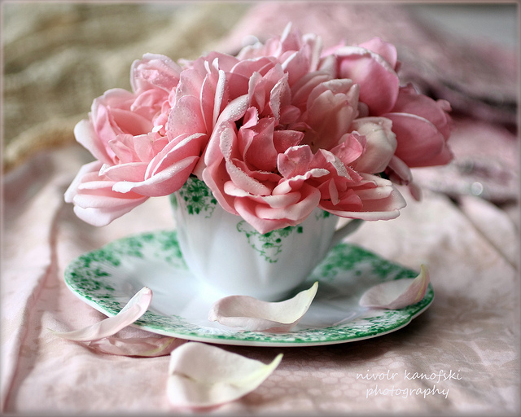
See you tomorrow.
Stay fine.

